Slide 1
TWO RIVERS PUBLIC SCHOOL DISTRICT 2020-21 BUDGET HEARING

Slide 2
Enrollment Projections 2020-2021
KOENIG | 2019-2020 | 2020-2021 | MAGEE | 2019-2020 | 2020-2021
Early Childhood | 13 | 4 | No Early Childhood or 4K at Magee
4K | 33 | 56
Kindergarten | 32 | 36 | Kindergarten | 61 | 68
Grade 1 | 33 | 40 | Grade 1 | 66 | 56
Grade 2 | 35 | 36 | Grade 2 | 65 | 63
Grade 3 | 48 | 35 | Grade 3 | 72 | 65
Grade 4 | 39 | 52 | Grade 4 | 80 | 66
TOTAL | 233 | 259 | TOTAL | 344 | 318
4K – Other Sites | 2019-2020 | 2020-2021
Creative Learning | 18 | 17
Good Shepherd | 18 | NA
Head Start | 15 | 9
Tiny Treasures | 17 | NA
TOTAL | 68 | 26
L.B. Clarke | 2019-2020 | 2020-2021 | TRHS | 2019-2020 | 2020-2021
Grade 5 | 130 | 120 | Grade 9 | 135 | 104
Grade 6 | 139 | 128 | Grade 10 | 129 | 123
Grade 7 | 121 | 143 | Grade 11 | 107 | 136
Grade 8 | 115 | 120 | Grade 12 | 113 | 115
TOTAL | 505 | 511 | TOTAL | 484 | 478

Slide 3
LIGHTHOUSE LEARNING ACADEMY
Grade | 2019-2020 | 2020-2021
4K | 4 | 12
Kindergarten | 7 | 12
Grade 1 | 5 | 17
Grade 2 | 8 | 11
Grade 3 | 9 | 13
Grade 4 | 5 | 17
Grade 5 | 9 | 8
Grade 6 | 8 | 12
Grade 7 | 5 | 11
Grade 8 | 10 | 5
Grade 9 | 4 | 11
Grade 10 | 5 | 5
Grade 11 | 6 | 7
Grade 12 | 8 | 5
TOTAL: | 93 | 146
Two Rivers Public School District TOTAL ENROLLMENT
 | 2019-2020 | 2020-2021
Early Childhood | 13 | 4
4K | 101 | 82
Kindergarten | 93 | 104
Grades 1-4 | 438 | 413
Grades 5-8 | 505 | 511
Grades 9-12 | 484 | 478
Lighthouse Learning Academy | 93 | 146
TOTAL | 1,727 | 1,738
Lighthouse Learning Academy
Lighthouse Learning Academy
The totals in this area include the Lighthouse Learning Academy

Slide 4
2020-21 BUDGET SUMMARY
General Fund Budget $21,435,207
2019-20 Tax Levy (all funds) $5,666,081
2020-21 Projected Tax Levy (all funds) $5,028,473
Total Projected Tax Levy Decrease ($637,608)
% of Tax Levy Decrease (11.25%)
Fund 10 Decrease ($91,200)
Fund 38 Increase $657,617
Fund 39 Decrease ($1,346,025)
Fund 80 Increase $142,000

Slide 5
MILL RATE COMPARISON
2020-21 2020-21 2019-20
LEVY Mill Rate Mill Rate
2020-21 Projected Operating Levy $3,111,491 $5.26 $5.41
2020-21 Debt Service Levy (Fund 39):
2011 Bonds $ 0 0.00 3.46
2017 Bonds 814,075 1.38 0.19
2020-21 Debt Service Levy (Fund 38):
2013 Bonds $257,633 0.43 0.43
2015 Bonds 703,274 1.19 0.08
2020-21 Community Service Fund Levy
(School Resource Officers) $142,000 0.24 0.00
2020-21 Projected Tax Levy $5,028,473 $ 8.50 $9.57
2019-20 Tax Levy $5,666,081 $9.57
Projected Decrease in Mill Rate ($1.07)
Projected Decrease in Tax Levy ($637,608)
Based on an estimated 0.0% increase in equalized value of property.

Slide 6
Energy Efficiency Exemption
REVENUE LIMIT EXEMPTION BACKGROUND: 2011 Wisconsin Act 32 and 2013 Wisconsin Act 20 provided that the revenue limit for the school year is increased by the amount spent by the school district in that school year on a project to implement energy efficiency measures or to purchase energy efficiency products including the payment of debt service on a bond or note issued to finance the project if the project results in the avoidance of, or reduction in, energy costs or operational costs.
The 2019-20 tax levy included $49,307 for energy efficiency project debt payments.

Slide 7
§ 121.91 (4) (o) Revenue Limit Exemption for Energy Efficiencies-Evaluation of the Energy Performance Indicators

Slide 8
HISTORY OF TAX LEVY AND MILL RATES
TWO RIVERS PUBLIC SCHOOLS
HISTORY OF TAX LEVY AND MILL RATES
School | Tax | Equalized
Year | Levy | Tax Rate
2008-09 | 5,893,686 | 9.49
2009-10 | 6,195,497 | 9.69
2010-11 | 6,069,695 | 9.92
2011-12 | 5,979,398 | 9.91
2012-13 | 6,020,330 | 10.39
2013-14 | 5,764,329 | 10.18
2014-15 | 5,735,733 | 10.24
2015-16 | 5,759,017 | 10.46
2016-17 | 5,266,801 | 9.38
2017-18 | 5,349,604 | 9.43
2018-19 | 5,488,996 | 9.83
2019-20 | 5,666,081 | 9.57
2020-21 | 5,028,473 | 8.50

Slide 9
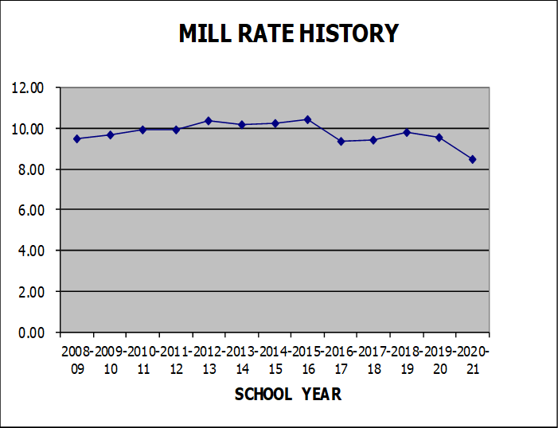

Slide 13
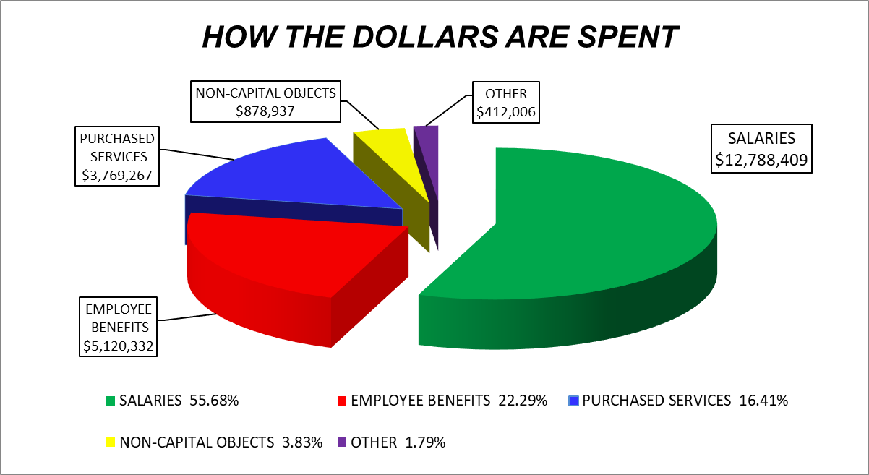

Slide 14
OPEN ENROLLMENT

Slide 16
LIGHTHOUSE LEARNING ACADEMY
Programming for Two Rivers residents and open enrolled students
Student enrollment – 146
Range 4K – 12
Current programming: virtual, home-school and/or blended

Slide 17
FUND 10 BUDGET INCREASE INFORMATION
2019-20 Actual General Fund Expenditures $20,235,470
2020-21 Budgeted General Fd Expenditures $21,435,207
Less: Amount budgeted from Fund Balance ($92,958)
Net 2020-21 Expenditures-Excl. Fund Balance $21,342,249
TOTAL BUDGET INCREASE $1,106,779
% BUDGET INCREASE 5.47%

Slide 19
FUND 73 – EMPLOYEE BENEFIT TRUST FUND SUMMARY
Balance of the trust – June 30, 2020 $744,744.70
Investment Return – June 30, 2020 $12,670.60
Contributions – July 1, 2019 to June 30, 2020 $409,270.77
Distributions – July 1, 2019 to June 30, 2020 $374,270.77
Investment Manager:
Trust Administrator: MidAmerica Administrative &
Retirement Solutions, Inc.
Custodians of the Trust: AUL – Rate of Return 1.80%

Slide 20
FUND 10 - FUND BALANCE SUMMARY
2020-21 BEGINNING FUND BALANCE $4,795,831
Budgeted Revenue - General Fund 21,342,249
Budgeted Expenses - General Fund (21,435,207)
2020-21 BUDGETED ENDING FUND BALANCE $4,702,873
FUND BALANCE APPROPRIATION:
L.B. Clarke Middle School Wall Installation $25,770
District Match for Wisconsin Fast Forward Grant 28,026
Risk Participation Agreement with Humana Insurance 29,546
Rollover of Building Budget Dollars from 2019-20 9,616
TOTAL FUND BALANCE APPROPRIATION $92,958

